Slide 1
Course ID: CSE - 471
Course Title: System Analysis and Design
Course Teacher: Dr. Muhammad Iqbal Hossain
Assistant professor Department of Computer Science & Engineering BRAC University.

Slide 2
Segment 1:What is System analysis and design
Segment 2: Software lifecycle
Segment 3: Structured design Methodologies
Segment 4: Rapid development Methodologies
Segment 5: Project Team Roles and Skills

Slide 3
Task for students
Every student need to attend the online lectures in every week.
While proceeding with the video lectures there might be pop-up quizzes, segment quiz etc. You need to participate in those quizzes to proceed to next lecture. Please note that these quizzes will be used for evaluation. So listen the lectures carefully and take the quiz.
Faculties will be available ONLINE (google meets) in the class time (according to the USIS) where students can join and discuss different topics, difficulties etc. You will be provided the link to join. Make sure you have finished the online lecture before joining the class meeting.
Assignment needs to be submitted by the provided deadline.

Slide 4
Segment 1
What is System analysis and design

Slide 5
Information System
Information systems are software applications which manage large amounts of data, share information etc.
Most of the software out there is information systems software,
written in languages such as Java, C++, .NET and the like.

Slide 6
Components of information systems
Hardware- these are the devices like the monitor, processor, printer and keyboard, all of which work together to accept, process, show data and information.
Software- are the programs that allow the hardware to process the data.
Databases- are the gathering of associated files or tables containing related data.
Networks- are a connecting system that allows diverse computers to distribute resources.
Procedures- are the commands for combining the components above to process information and produce the preferred output.
Notes:
Facebook processes 2.5 billion pieces of content and 500+ terabytes of data each day. It’s pulling in 2.7 billion Like actions and 300 million photos per day, and it scans roughly 105 terabytes of data each half hour.
Youtube: 100 million videos watched per day, 65,000 videos added each day, 60% of all videos watched online, At least 45 terabytes of videos

Slide 7
The Bad News
30% of large IT projects are cancelled before completion
50% of IT projects are over-budget by more than 200%
The majority of completed projects deliver 60% or less of prescribed functionality
Many delivered information systems are under-used because they don’t meet user needs and/or expectations
Legacy systems are a serious and growing bottleneck to organizational evolution

Slide 8

Software Horror Stories
Bank of America spent $23,000,000 on a 5-year project to develop a new accounting system. Spent over $60,000,000 trying to make new system work, finally abandoned it. Loss of business estimated in excess of $1,000,000,000
The B1 Bomber required an additional $1,000,000,000 to improve its air defense software, but the software still isn’t working to specification
Ariane 5, Flight 501
The loss of a $500,000,000 spacecraft was ultimately attributed to errors in requirements, specifications and inadequate software reuse practices.

Slide 9
Why is this Course Important?
Most errors (54%) are detected after coding and testing.
Almost half of all errors in software (45%) are in requirements and design.
Most errors made during requirements analysis are non-clerical (77%)
Requirements errors can cost up to 100 times more to fix than implementation errors
if they are not caught early on.
Need to do requirements and design right!

Slide 10
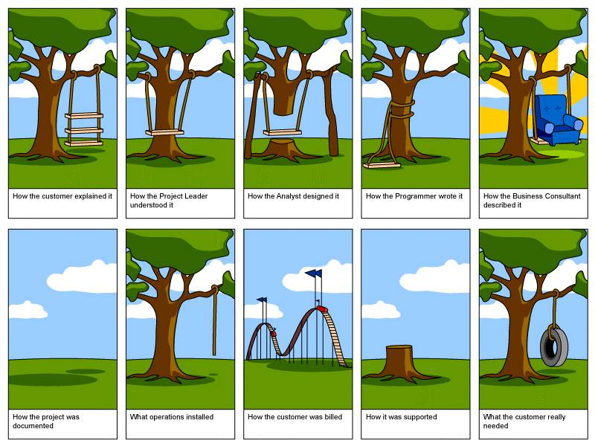

Slide 11
Key Ideas
Many failed systems were abandoned because analysts tried to build wonderful systems without understanding the organization.
The primary goal is to create value for the organization.

Slide 12
Key Ideas
Systems analyst is a key person
analyzing the business
identifying opportunities for improvement
designing information systems to implement these ideas.

Slide 13
What is System Analysis?
The collection of notations, methodologies and tools used to gather details and analyze a problem situation prior to information system design and implementation
Systems analysis (or, requirements analysis) must ensure that the proposed information system meets user needs, can be delivered on time, and can be updated inexpensively.
Problems in "getting the systems analysis right", such as ill-defined situations, ambiguities, inconsistencies, mixing requirements with design

Slide 14
Need for Systems Analysis?
Remember, finding and fixing a fault after software delivery is 100x more expensive than finding and fixing it during systems analysis or early design phases

Slide 15
Segment 2 Software lifecycle

Slide 16
Major Attributes of the Lifecycle
The project
Moves systematically through phases where each phase has a standard set of outputs
Produces project deliverables
Uses deliverables in implementation
Results in actual information system
Uses gradual refinement

Slide 17
Project Phases
Planning
Why build the system?
Analysis
Who, what, when, where will the system be?
Design
How will the system work?
Implementation
System delivery

Slide 18
Planning
Identifying business value
Analyze feasibility
Develop work plan
Staff the project
Control and direct project

Slide 19
Analysis
Analysis strategy
Analysis of current system
Ways to design new system
Requirements gathering
Interviews, questionnaires
Process modeling
Data modeling

Slide 20
Design
Architectural design
Hardware
Software
Network infrastructure
Interface design
Database and file design
Program design

Slide 21
Implementation
Construction
Writing programs
Testing
Installation
Replace old with new system
Training users
Support Plan

Slide 22
Processes and Deliverables
Process
Product
Project Plan
System Proposal
System
Specification
New System and
Maintenance Plan
Planning
Analysis
Design
Implementation

Slide 23
What Is a Methodology?
A formalized approach or series of steps to implement SDLC
Methodology categories:
Process-centered
Data-centered
Object-oriented

Slide 24
Need for methodology
Writing code without a well-thought-out system request may work for small programs, but rarely works for large ones.
Need to have a good design from the requirements before moving on to implementation.

Slide 25
Systems development methodologies
Structured Design
Waterfall Development
Parallel Development
Rapid Application Development (RAD)
Phased Development
Prototyping
Agile Development
Extreme Programming

Slide 26
Segment 3
Structured design Methodologies

Slide 27
Structured Design
Projects move methodically from one to the next step
Generally, a step is finished before the next one begins

Slide 28
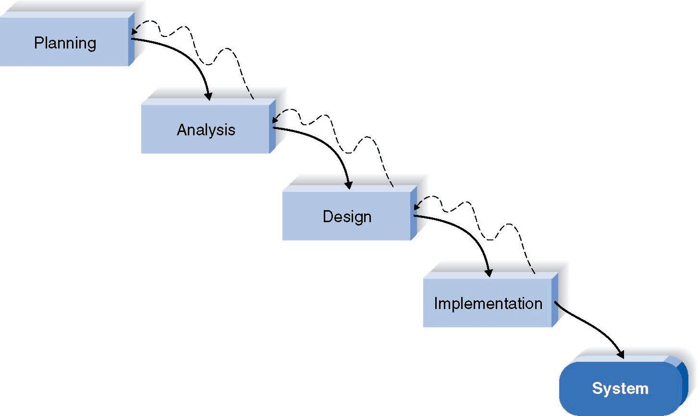
Waterfall Development Method

Slide 29
Pros and Cons of the Waterfall Method
Pros
Cons
Identifies systems
requirements long
before programming
begins
Design must be
specified on paper
before programming
begins
Long time between
system proposal and
delivery of new
system

Slide 30
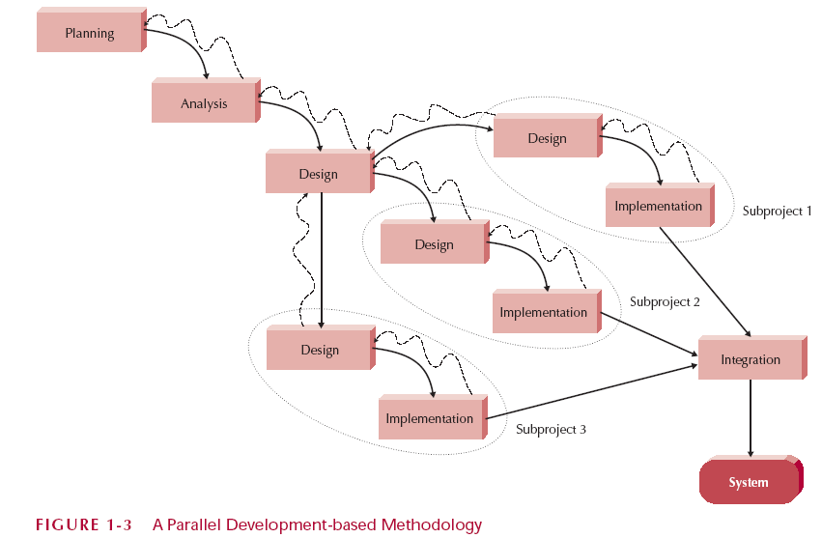
Parallel Development

Slide 31
Pros and Cons of the Parallel Method
Pros
Cons
Reduce schedule time
to deliver the system
Subprojects may not
be completely
independent –
integration may be
complicated
Paper document
outputs still cause
problems

Slide 32
Segment 4
Rapid development Methodologies

Slide 33
Rapid Application Development
Critical elements
CASE tools (Computer-Aided Software Engineering (CASE))
JAD sessions (Joint Application Design)
Fourth generation/visualization programming languages
Code generators

Slide 34
Rapid Application Development Categories
Phased development
A series of versions
Prototyping
System prototyping
Throw-away prototyping
Design prototyping
Agile Development
Extreme Development

Slide 35
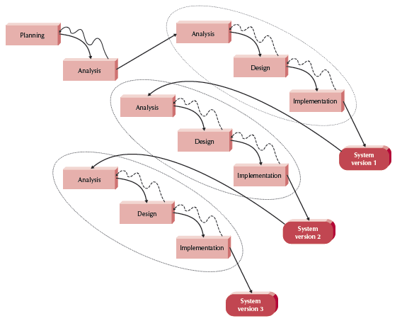
Phased development

Slide 36
Pros and Cons of Phased development
Pros:
Users gain early process and software knowledge now that they can use in the subsequent phases.
Issues with one phase only affect a small area of the business
Core project team can learn from the initial phases and use their new found knowledge for subsequent phases.
Cons:
Project duration for full implementation is long
If you are on a tight/limited budget this can prove costly.
Need to supply critical modules which will be integrated at the end.

Slide 37
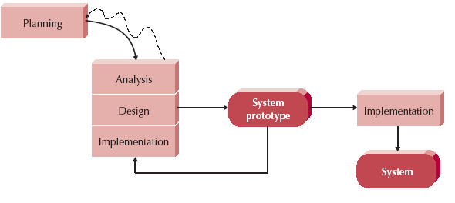
How Prototyping Works

Slide 38
Pros and Cons of Prototyping
Pros:
Users are actively involved in the development
Since in this methodology a working model of the system is provided, the users get a better understanding of the system being developed.
Errors can be detected much earlier.
Quicker user feedback is available leading to better solutions.
Missing functionality can be identified easily
Cons:
Practically, this methodology may increase the complexity of the system as scope of the system may expand beyond original plans.
Incomplete application may cause application not to be used as the full system was designed

Slide 39
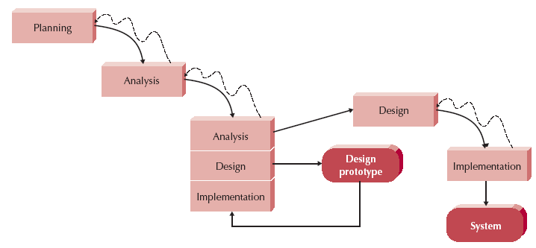
Throwaway Prototyping

Slide 40
Pros and Cons of Throwaway Prototyping
Pros:
it is very cost-effective.
Throwaway Prototyping model uses a series of prototypes to detect and forecast possible problems, it can prevent these from taking place as soon as the product or service is introduced to the market.
Project completion is quick. Since it allows early detection of issues, the transition from one step to the next will be smoother and faster.
Cons:
Since the process involved in prototyping is done in rapid speed, it is possible that a lot of aspects can be overlooked.
Confusion on the part of users and developers can also occur because it is likely to get so used to the prototype that differentiating it from the real one can become a challenge.

Slide 41

Extreme Programming
Perhaps the best-known and most widely used agile method.
Extreme Programming (XP) takes an ‘extreme’ approach to iterative development.
New versions may be built several times per day;
Increments are delivered to customers every 2 weeks;
All tests must be run for every build and the build is only accepted if tests run successfully.

Slide 42
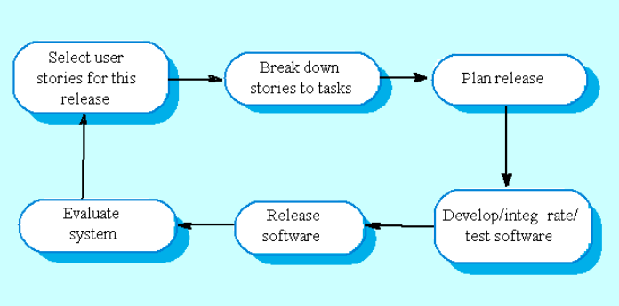
Extreme Programming

Slide 43
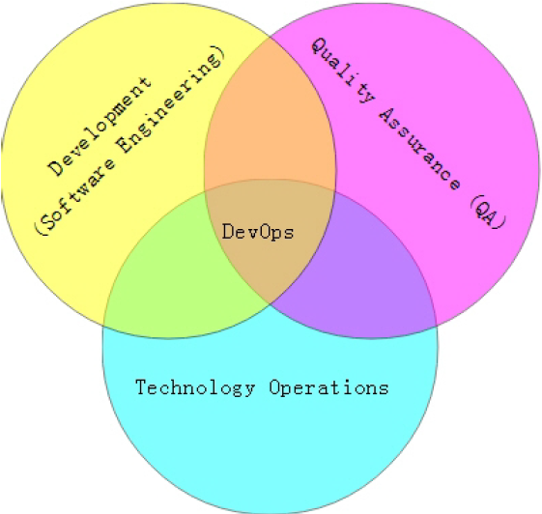
What is DevOps?
DevOps = development & operations
A Methodology of Continuous Delivery
A software development method that stresses communication, collaboration and integration between development and IT professionals.
“Streamlining release process” .

Slide 44
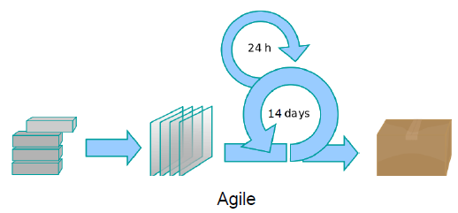
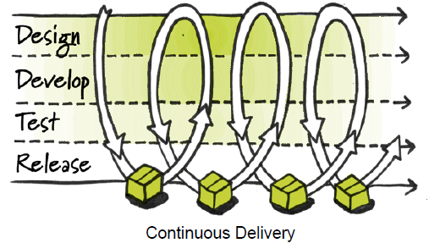
DevOps vs. Agile
DevOps is especially complementary to the Agile software development process.
extends and completes the continuous integration and release process by ensuring that code is production ready and will provide value to the customer
DevOps enables a far more continuous flow of work into IT Operations.
If development delivers code every two weeks but it's deployed only every two months, customers don't get value and the deployments often result in chaos and disruption.

Slide 45
Selecting the Appropriate Methodology
Clarity of User Requirements
Familiarity with Technology
System Complexity
System Reliability
Short Time Schedules
Schedule Visibility

Slide 46
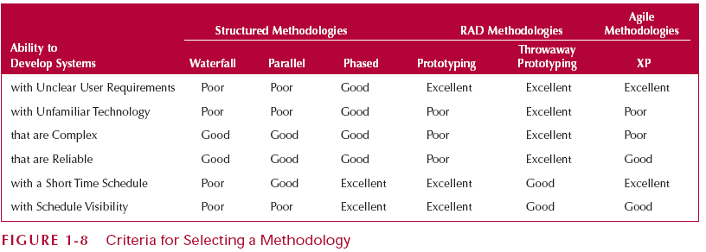
Criteria for Selecting a Methodology

Slide 47
Segment 5 Project Team Roles and Skills

Slide 48
Information Systems Roles
Business analyst
System analyst
Infrastructure analyst
Change management analyst
Project manager

Slide 49
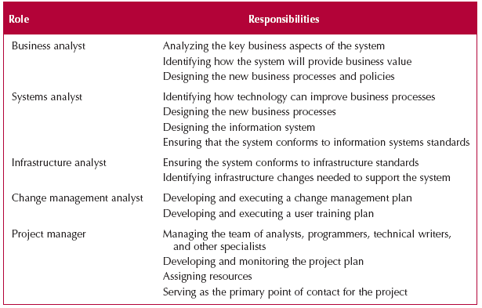
Project Team Roles

Slide 50
Summary -- Part 1
The Systems Development Life Cycle consists of four stages: Planning, Analysis, Design, and Implementation
The major development methodologies:
Structured design
the waterfall method
Parallel development
RAD development
Prototyping (regular and throwaway)
Agile development
XP streamline SDLC

Slide 51
Summary -- Part 2
There are five major team roles: business analyst, systems analyst, infrastructure analyst, change management analyst and project manager.

